Slide 1
The Conservation of Energy for a Particle
Dr. Jacob Moore
Associate Professor of Engineering
Penn State Mont Alto

Slide 2
Work and Energy Method
So far...
We have used kinematics to relate position, velocity, and acceleration.
And we have used the force mass and acceleration branch of kinetics, to relate forces to accelerations.
We are now going to discuss work and energy methods (another branch of kinetics), as an alternative to the force, mass, and acceleration method.

Slide 3
Work and Energy Method
The work and energy methods provide an alternative to the force, mass acceleration method.
Almost all kinetics problems can be solved either way.
The force mass acceleration method will be easier in some cases.
The work energy method will be easier in some other cases.
(The impulse momentum method will be easier in some third set of cases).

Slide 4
Work and Energy Method
The work energy method is best summarized as this...
“The work done to a system will be equal to the change in the system’s energy”
Work is...
A force applied over a distance
Energy is...
Translational or Rotational Kinetic Energy
Gravitational or Elastic Potential Energy (a replacement for work done by gravity forces or work done by elastic / spring forces)

Slide 5
The Conservation of Energy
If we put all of the pieces together in a single equation, we wind up with the conservation of energy equation.
$$W=∆KE+∆PE$$
All work an energy equations will start with this simple equation, which will be adapted based on what we know.

Slide 6
Work
The work done to a system (at least a dynamic system) will be equal a force times a distance.
$$F_{push}$$
d
$$F_{friction}$$
$W_{push}=F_{push}∗d$
$W_{friction}=−F_{friction}∗d$

Slide 7
Work
Only the component of the force in the direction of the motion does work on the system.
$$F_{push}$$
θ
d
$$F_{normal}$$
$W_{push}=F_{push}cos⁡(θ)∗d$
$$W_{normal}=0$$

Slide 8
Work
Sometimes we will encounter a force that changes as the body moves.
In cases such as this, the work done by the force will be the integral of the force function over the distance traveled.
$$W=\int_{x min}^{x max}{F(x) dx}$$
$$F$$
$$F\left(x\right)= …$$
$$x$$
x

Slide 9
Kinetic Energy
The kinetic energy of a body of a particle will be as follows
$$KE=\frac{1}{2}mv^{2}$$
In our conservation of energy equation, we use the change in kinetic energy, which assuming constant mass is…
$$∆KE=\frac{1}{2}m{v_{f}}^{2}−\frac{1}{2}m{v_{i}}^{2}$$
speed of object
mass of object

Slide 10
Kinetic Energy
While the direction of the force was important for work, the direction for the velocity for kinetic energy is not important.
Kinetic energy (and potential energy) are scalar values.
They do not have a direction
They cannot be broken down into components
Kinetic and potential energy cannot be negative (though changes can be negative)

Slide 11
Potential Energy
Potential energy has many forms, but in this course we will focus on two, gravitational potential energy and elastic potential energy.
Gravitational Potential Energy
$$∆PE=mg∆h$$
Elastic Potential Energy
$$∆PE=\frac{1}{2}k{x_{f}}^{2}−\frac{1}{2}k{x_{i}}^{2}$$
Change in height of the object
acceleration
of gravity
difference in length
from resting length
elastic spring
constant

Slide 12
Gravitational Potential Energy
The gravitational potential energy is not really an energy at all, but instead represents the force gravity will do to a body as it moves.
$$W_{gravity}=−mgΔh$$
This quantity becomes positive when we move it to the energy side of our conservation of energy equation
$$F_{g}=mg$$
$$d = ∆h$$

Slide 13
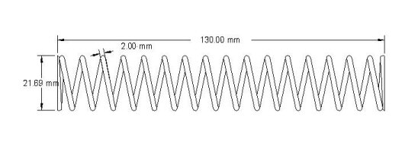
Elastic Potential Energy
The elastic potential energy represents the force a spring exerts on a body as it moves
Imagine we have spring that exerts a force on a mass m as it travels from point A (resting length of spring) to point B.
The magnitude of this force will be k*x at each point along this path.
$$F_{spring}$$
$$F_{spring}=kx$$
x

Slide 14
Work for Forces that Change Over Time
To find the work done by the spring force we will have to integrate over the distance traveled.
$$W_{spring}=\int_{0}^{x}{−kx dx}=−\frac{1}{2}kx^{2}$$
$$F_{spring}$$
$$F_{spring}=kx$$
x

Slide 15
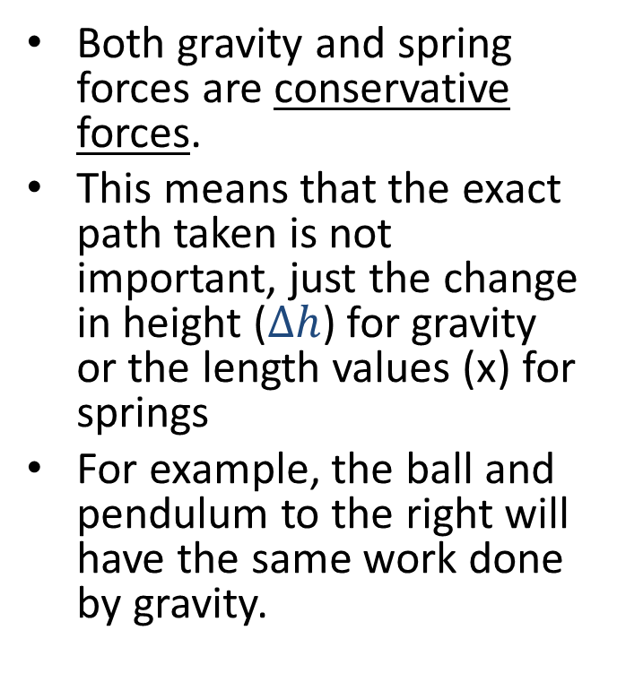
Path Independence and Potential Energy
Both gravity and spring forces are conservative forces.
This means that the exact path taken is not important, just the change in height ($∆h$) for gravity or the length values (x) for springs
For example, the ball and pendulum to the right will have the same work done by gravity.
$$F_{g}$$
$$F_{g}$$
$$∆h$$

Slide 16
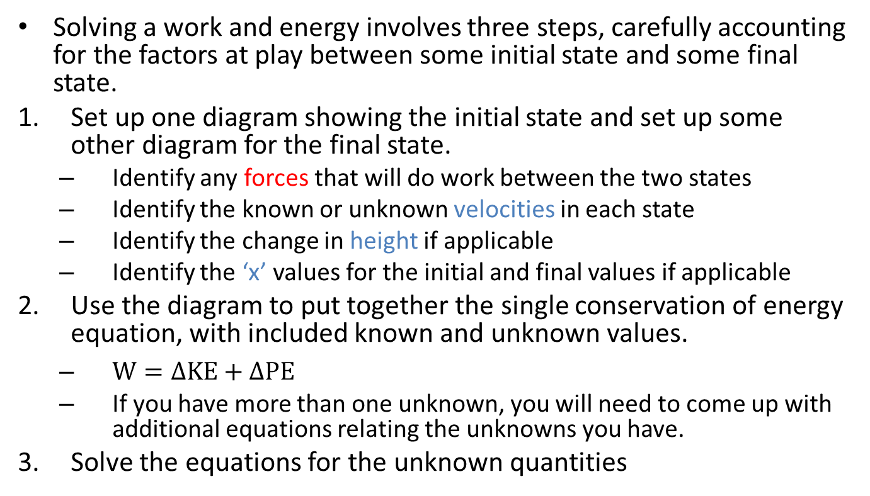
Solving a Work and Energy Problem (The Process)
Solving a work and energy involves three steps, carefully accounting for the factors at play between some initial state and some final state.
Set up one diagram showing the initial state and set up some other diagram for the final state.
Identify any forces that will do work between the two states
Identify the known or unknown velocities in each state
Identify the change in height if applicable
Identify the ‘x’ values for the initial and final values if applicable
Use the diagram to put together the single conservation of energy equation, with included known and unknown values.
$W=∆KE+∆PE$
If you have more than one unknown, you will need to come up with additional equations relating the unknowns you have.
Solve the equations for the unknown quantities

Slide 17
Thanks for Watching
See other engineering mechanics videos and access the full tool at…

Slide 18
Work Worked Example
A 16 lb crate slides down a ramp as shown to the right. If the crate is released from a height of 10 ft
What is the work done by gravity?
What is the change in gravitational potential energy
10ft
60º

Slide 19
Work and Energy Worked Example
A spring with an unstretched length of 40 cm and a k value of 120 n/cm is used to lift a 5 kilogram box from a height of 20 cm to a height of 30 cm. If the box starts at rest, what would you expect the final velocity to be?
5 kg
5 kg
30 cm

Slide 20
Work and Energy Practice Problem
A 2000 lb wrecking ball hangs from the end of a 40 ft cable. If the wrecking ball is released from an angle of 40 degrees, what would we expect the maximum velocity at the bottom point to be?
40º

Slide 21
Work and Energy Worked Example
A 24,000 kg aircraft is launched from an aircraft carrier using the a hydraulic catapult. If the force the catapult exerts over the 90m runway is shown below...
What is the work done by the catapult?
What is the speed of the plane at the end of the runway?
$$F=1240 kN$$
$$F=205 kN$$
x
$$x=90m$$

